Slide 1
Improve Image Classification Using Data Augmentation & Neural Network
CSI 6160 Machine Learning
Group -5
Riya Singh
Charmi Shah

Slide 2
Presented By:
Presented by:
Shanqing Gu - Southern Methodist University, shanqingg@smu.edu
Manisha Pednekar - Southern Methodist University, mpednekar@smu.edu
Robert Slater - Southern Methodist University, rslater@smu.edu
Reference: https://scholar.smu.edu/cgi/viewcontent.cgi?article=1091&context=datasciencerevie

Slide 3
Introduction
In machine learning, image classification is a process to analyze the extracted image features and organize them into categories by using neural networks.
These techniques are practically applied in many fields such as AI, Medical Diagnostics, E-commerce, gaming or automotive industries.
Notes:
In machine learning, image classification is a process to analyze the extracted image features and organize them into categories by using neural networks.

Slide 4
Motivation
We tried to reduce model overfitting and improve image classification to build a reliable model with three strategies:
Refining model architectures by adjusting filter sizes and adding more convolutional, max pooling and dropout layers
Optimizing Hyperparameter selection (e.g Optimizer Adamax and activation function elu)
Implementing Data Augmentation with common techniques( Rotation, flip, translation, Gaussian Noises)

Slide 5
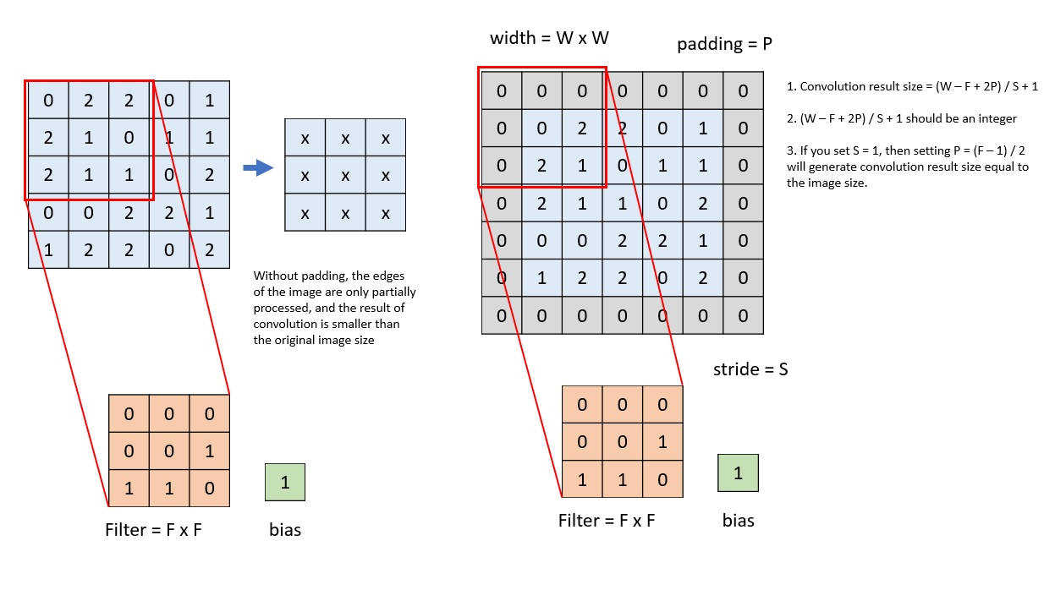
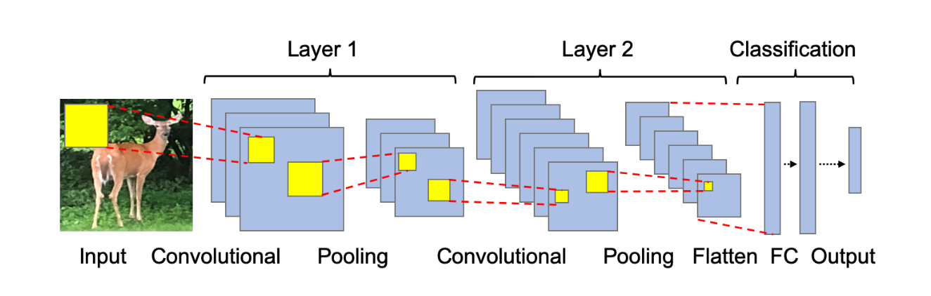
Convolutional Neural Network
A CNN model generally contains more than one convolutional layer for specialized linear operations and includes local or global pooling layers to perform nonlinear downsampling.
After learning features from many layers, a fully connected layer outputs the probabilities for each class to be predicted.
Notes:
An example of CNN architecture. It contains convolutional, pooling and fully- connected layers for regression. The yellow square is to show the example filter (a.k.a. convolutional kernel or K). The values from the output node represent the classified physical objects, such as deer

Slide 6
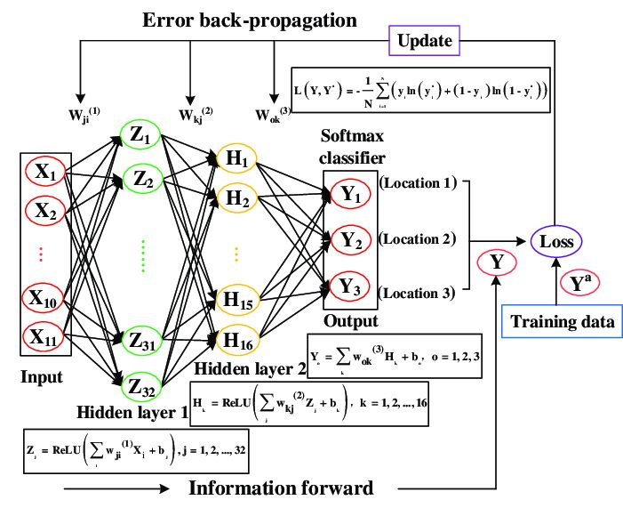
Convolutional Neural Network Architecture

Slide 7
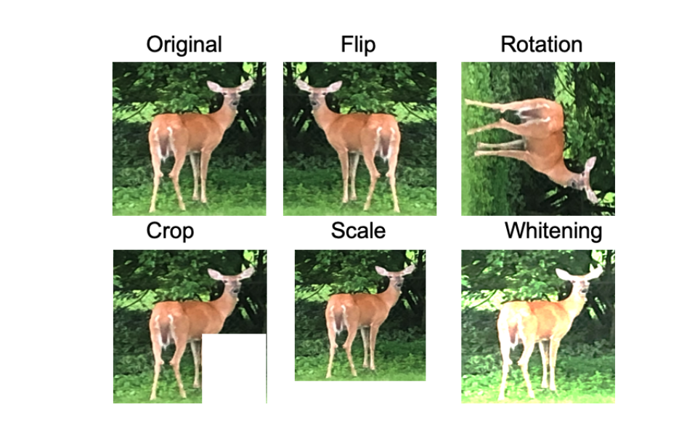
Data Augmentation
In addition, regularization technique like dropout, early stopping, batch-normalization can be applied in order to prevent overfitting of the model and Data augmentation is also considered as regularization technique for neural networks
Data augmentation is one of the important image preprocessing techniques to generate more training data and reduce model over- fitting
Image data augmentation techniques generate more training data from original data and require no additional memory for storage
The common techniques are to prevent overfitting & enhance learning capability.
Flip Horizontally or Vertically
Rotate at some degrees
Scale outward or inward
Crop Randomly
Translate
Add Gaussian Noise
Notes:
However, model overfitting and poor performance are common problems in applying neural network techniques because some of the high frequency features may not be useful in classification
(1) flip horizontally or vertically; (2) rotate at some degrees; (3) scale outward or inward; (4) crop randomly; (5) translate; (6) add Gaussian noises to prevent overfitting and enhance the learning capability.

Slide 8
Dropout Layer
The objective is to reduce the importance of neurons by randomly switching some neurons off on the training stage.
The hyperparameter used for this techniques is called dropout rate.
Notes:
The objective is to reduce the importance of neurons by randomly switching some neurons off on the training stage.

Slide 9
Batch Normalization
Batch normalization is a layer that allows every layer of the network to do learning more independently.
Using batch normalization learning becomes efficient also it can be used as regularization to avoid overfitting of the model.
It is often placed just after defining the sequential model and after the convolution and pooling layers.
Batch Norm is just another network layer that gets inserted between a hidden layer and the next hidden layer. Its job is to take the outputs from the first hidden layer and normalize them before passing them on as the input of the next hidden layer.

Slide 10
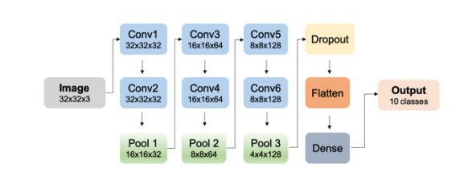
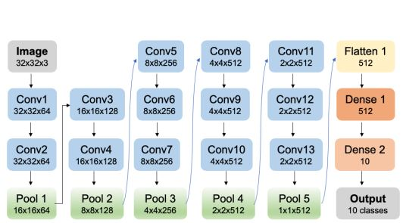
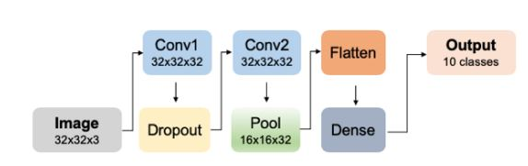
Model for Image Classification
M0
The shapes of 3D feature maps are passed between layers and their connections.
Conv1 and Conv2 have the same space size of 32x32x32, while the pooling layer has the space size of 16x16x32 after dimensionality reduction.
The flatten layer is used to adjust the feature maps to the dense layer. The output layer has ten neurons with one for each target class.
M DA
This model pattern is three stacks of two convolutional layers followed by three max-pooling layer.
The 3 filter numbers applied in the stacking convolutional layers slide from 32,64, 128 separately.
The flatten layer is used to adjust the feature maps to the dense layer with the probability output for ten classes.
We also added Batch Normalization layers.
VGG-16 Model
There are two stacks of two convolutional layers and three stacks of three convolutional layers followed by one pooling layer after every stack along with batch normalization before activation layer.
The filter numbers slide from 64 to 128, 256 and 512 separately in the stacked convolutional layers.

Slide 11
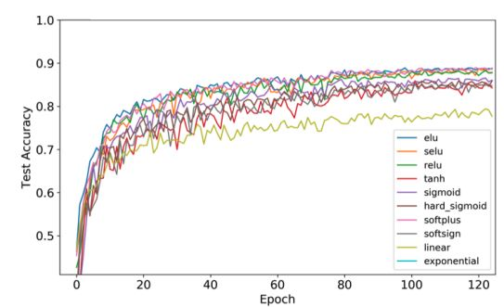
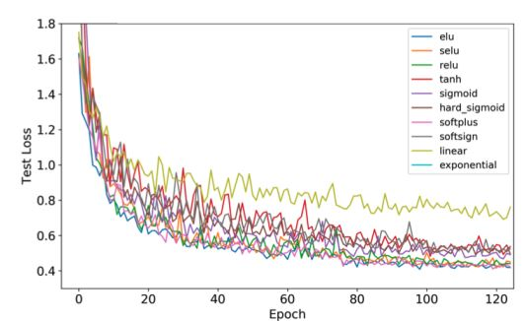
Activation Arguments
Compare ten different activation arguments with test accuracy in model MDA-1.The activation argument elu performs the best and linear performs the worst among all.
Compare ten different activation arguments with test loss in model M-DA1.The activation argument elu performs the best and linear performs the worst among all.

Slide 12
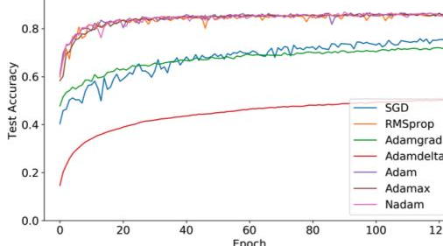
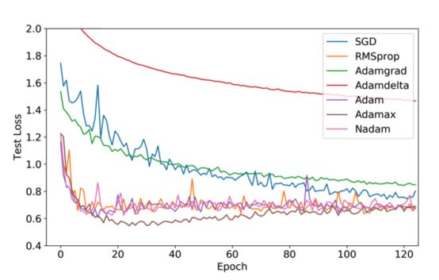
Optimizers
Compare seven different optimizers with test accuracy in model M-DA-0 architecture. The top four optimizers with high model performance are Adam, Adamax, RMSprop, and Nadam.
Compare seven different optimizers with test loss in model M-DA-0 architecture. Optimizer Adamax minimizes the loss function most.

Slide 13
t-SNE Visualization
The t-distributed Stochastic Neighbor Embedding (tSNE) algorithm has become one of the most used and insightful techniques for exploratory data analysis of high-dimensional data.
A powerful feature of tSNE is that it reveals clusters of high-dimensional data points at different scales while requiring only minimal tuning of its parameters.
The aim of tSNE is to cluster small “neighborhoods” of similar data points while also reducing the overall dimensionality of the data so it is more easily visualized.
In other words, the tSNE objective function measures how well these neighborhoods of similar data are preserved in the 2 or 3-dimensional space, and arranges them into clusters accordingly.

Slide 14
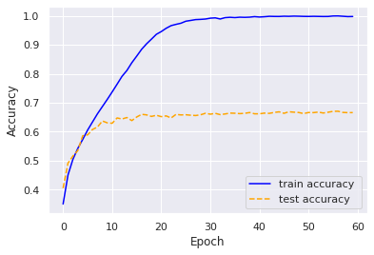
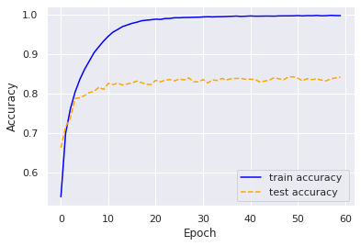
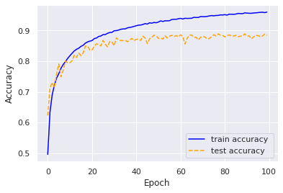

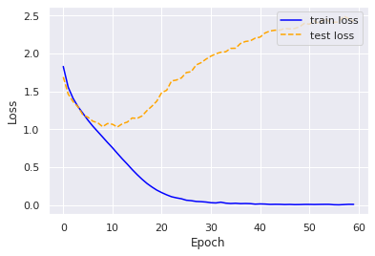
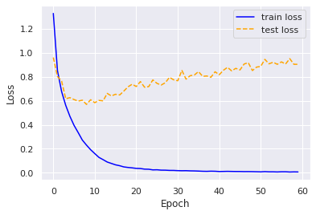
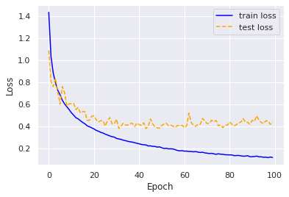
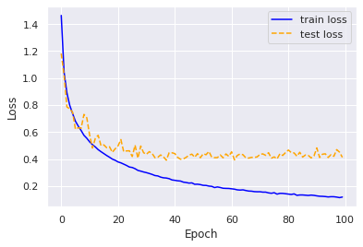
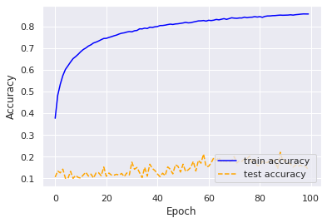
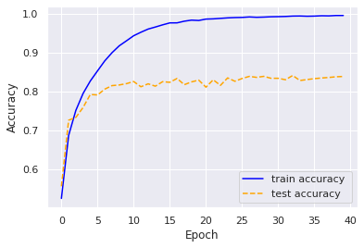
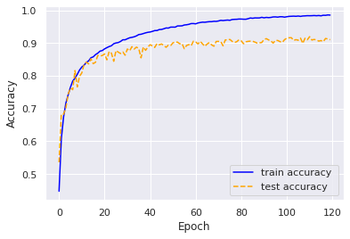
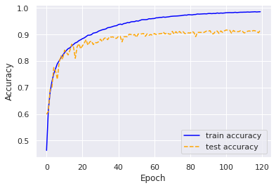
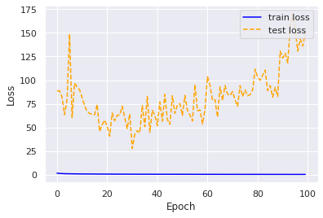
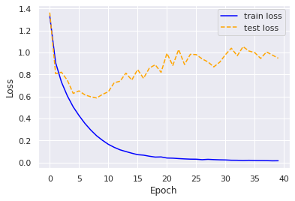
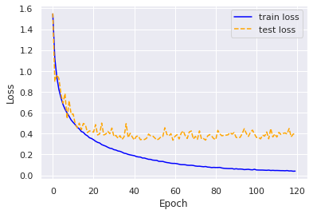
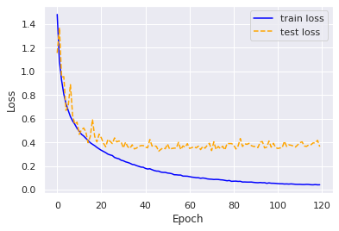
M0 Results
M-DA-0 (without data Augmentation)
M-DA-1 (Basic data Augmentation)
M-DA-2 (10% GN))
M-DA-3 extreme DA
VGG16-0 NO DA
VGG16-1 With DA
VGG16-2 With DA + 10% GN

Slide 15
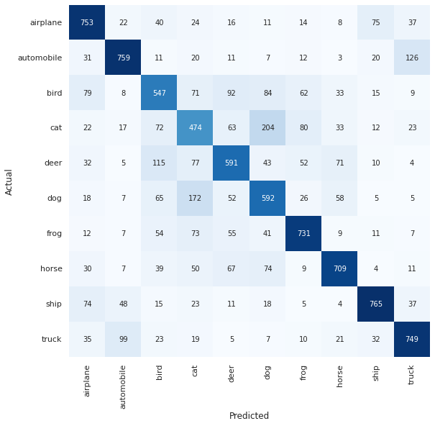
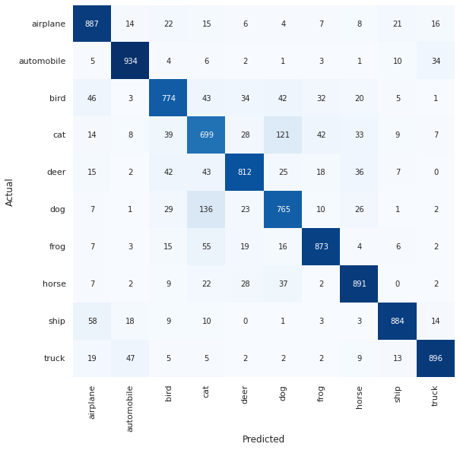
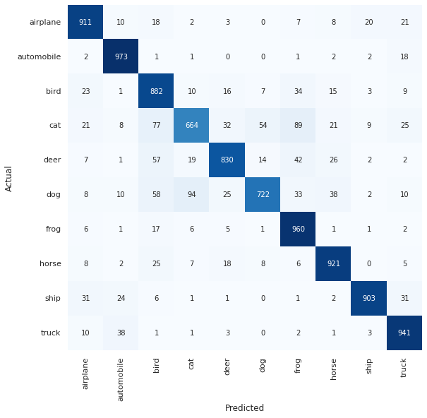

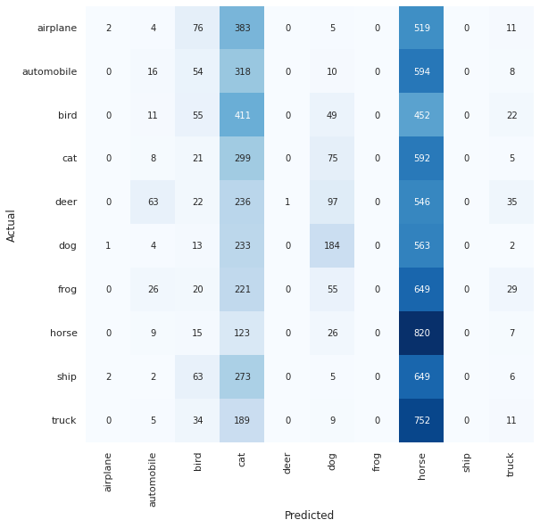
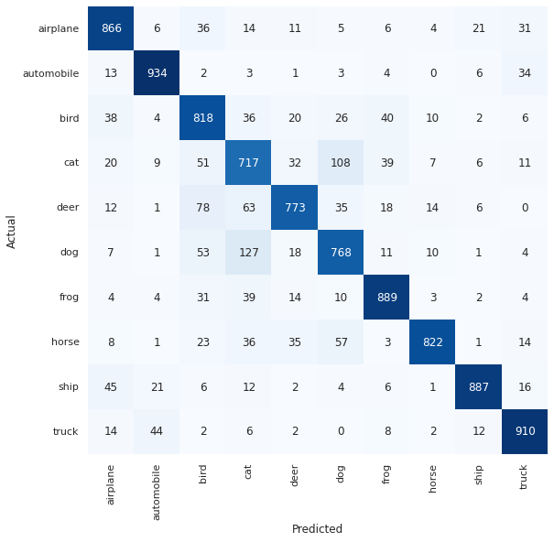


M0 Results | M-DA-0 (without data Augmentation) | M-DA-1 (Basic data Augmentation) | M-DA-2 (10% gaussian noise)
M-DA-3 extreme DA | VGG16-0 NO DA | VGG16-1 With DA | VGG16-2 With DA + 10% GN

Slide 16
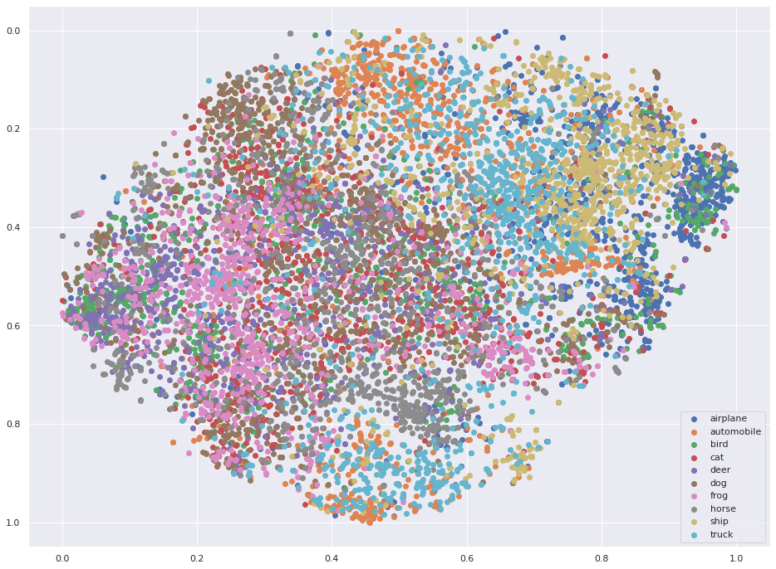
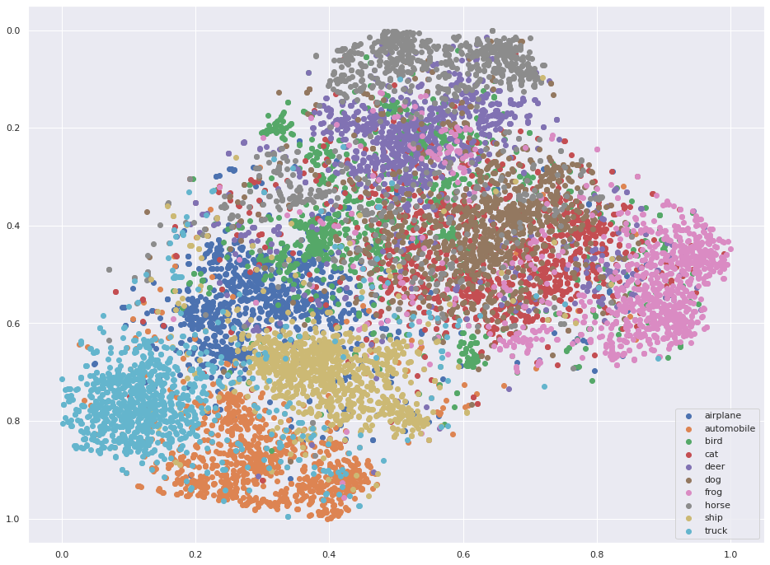
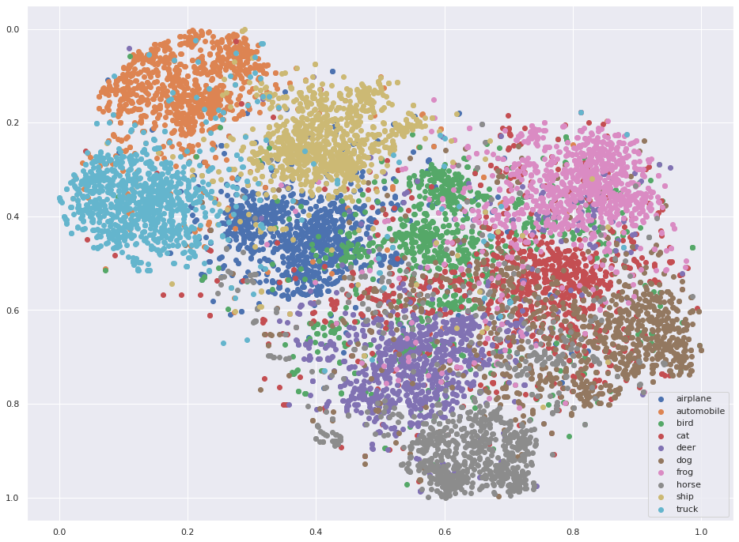
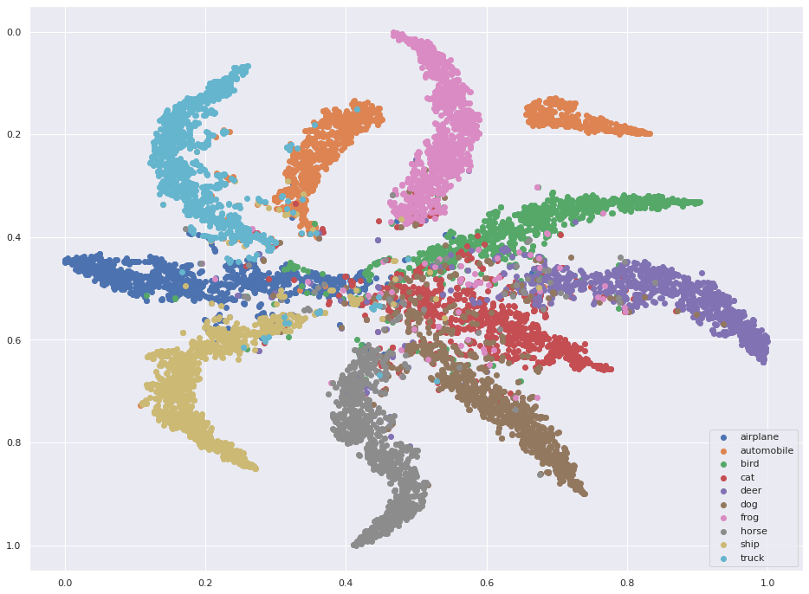
M0 Model ( 2 Conv Layer)
M-DA-0 Model (6 Conv Layer)
M-DA-1 Model ( 6 Conv Layer)
VGG-16-1 Model ( 13 Conv Layer)
16

Slide 17
M0
Standard M-DA
VGG-16
Data Augmentation
Convolutional Layers
Optimizer
Activation Argument
Model Overfitting
Train and Test Accuracy
Train and Test Loss
Confusion Matrix
t-SNE Visualization
NO DA
M-DA-0: No DA / M-DA-1: DA
M-DA-2: DA+GN
M-DA-3: Extreme DA
VGG-16-0: No DA
VGG-16-1: DA
VGG-16-2: DA + GN
2
6
13
SGD
Adamax(from 7 Optimizer)
Adamax(from 7 Optimizer)
relu
elu(from 10)
elu
Overfitting
reduce(M-DA-1,-2)
reduce(VGG-16-1,-2)
0.99 and 0.66
0.99 and 0.82- M-DA-0
0.96 and 0.88- M-DA-1
0.95 and 0.88- M-DA-2
0.73 and 0.15- M-DA-3
0.99 and 0.83- VGG-16-0
0.99 and 0.91- VGG-16-1
0.99 and 0.91- VGG-16-2
0.008 and 2.424
0.007 and 0.90- M-DA-0
0.11 and 0.43- M-DA-1
0.11 and 0.41- M-DA-2
0.73 and 39.69- M-DA-3
0.007 and 0.94- VGG-16-0
0.02 and 0.40- VGG-16-1
0.01 and 0.36- VGG-16-2
[753,749]
[887,896]- M-DA-0:
[911,941]- M-DA-1
[908,941]- M-DA-2
[866,910]- VGG-16-0
[925,938]- VGG-16-1
[931,948]- VGG-16-2
Unclassified
Improved for M-DA-0
Optimized for M-DA-1
Well Clustered(VGG-16-1)

Slide 18
File & Code Details
 | File Name | Description
1 | M0.ipynb | Model with 2 layer
2 | M DA-0.ipynb | Model with 6 Convolutional Layer
3 | M DA-1.ipynb | Model with 6 Conv Layer and Data Augmentation
4 | M DA-2.ipynb | Model with 6 Convolutional Layer and Data Augmentation + Gaussian Noise
5 | M DA-3.ipynb | Model with 6 Convolutional Layer and Extreme Data Augmentation
6 | VGG16-0.ipynb | Model with 13 Convolutional Layer
7 | VGG16-1.ipynb | Model with 13 Conv Layer and Data Augmentation
8 | VGG16-2.ipynb | Model with 6 Convolutional Layer and Data Augmentation + Gaussian Noise
*Note: Our Project is implemented on Keras. So we have implemented on GOOGLE COLAB with high GPU.

Slide 19
Thank You

Slide 20
References
https://quantdare.com/mitigating-overfitting-neural-networks/
https://ai.googleblog.com/2018/06/realtime-tsne-visualizations-with.html
https://towardsdatascience.com/batch-norm-explained-visually-how-it-works-and-why-neural-networks-need-it-b18919692739
Notes:
In machine learning, image classification is a process to analyze the extracted image features and organize them into categories by using neural networks.

